Slide 1
All About Kubernetes Certification Programs Christopher Hanson, Senior Associate Consultant RX-M Enterprises LLC

Slide 2
Why Participate?
Individuals
Certification allows Administrators and Developers to establish credibility, expertise and value in the competitive job market (not to mention keywords!)
Partner Organizations
Differentiate your professional services organization by demonstrating expertise in helping enterprises adopt Kubernetes
Platform Vendors
Gives end users the confidence that when they use a Certified Kubernetes product they can rely on a high level of common functionality
Gives Independent Software Vendors confidence that if their customer is using a Certified Kubernetes platform that their software will behave as expected

Slide 3
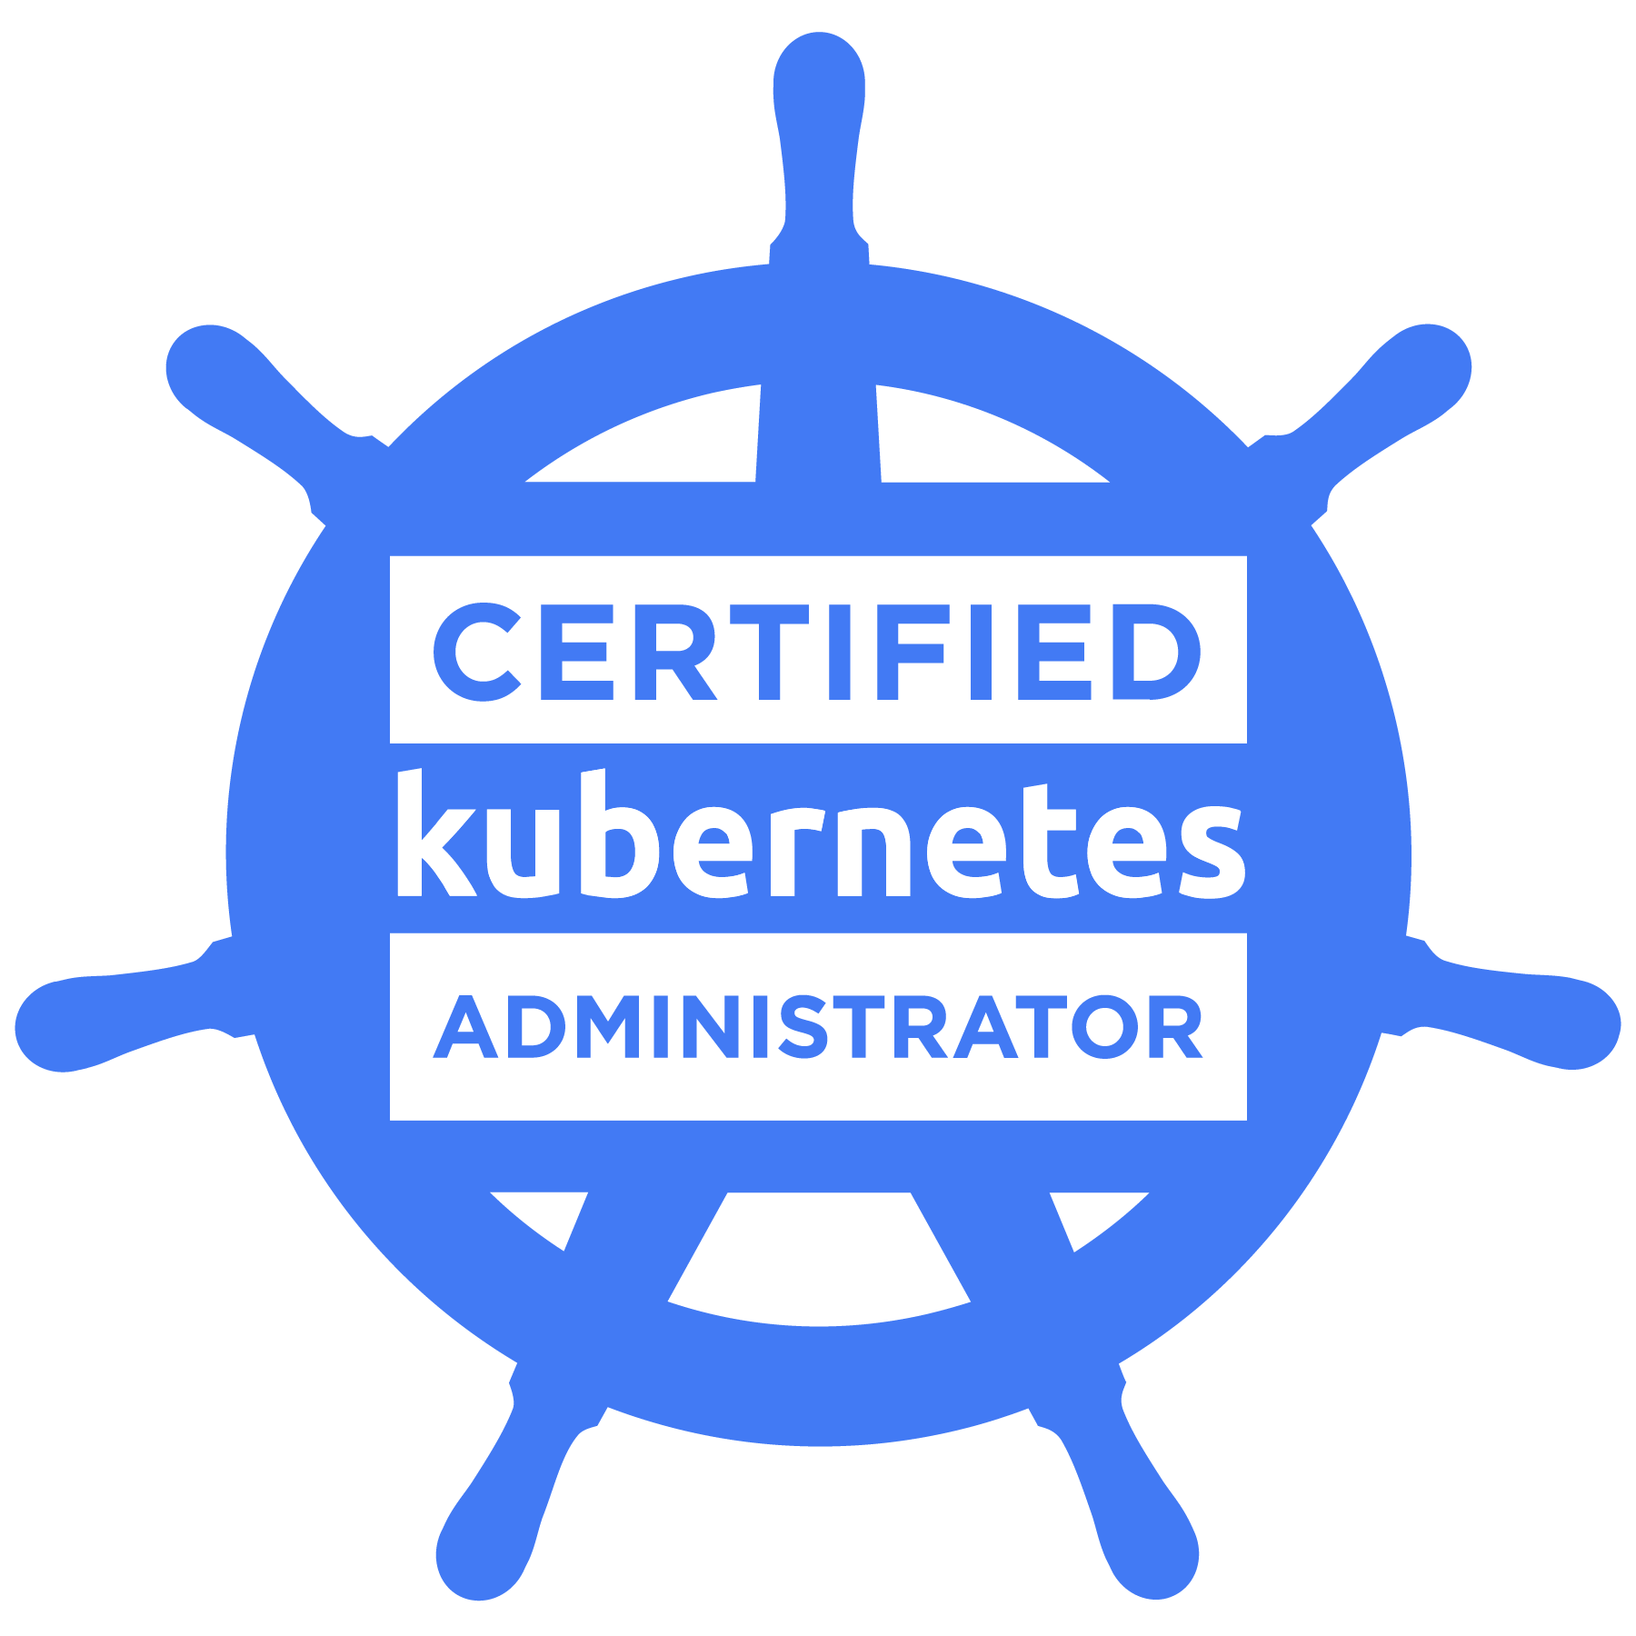
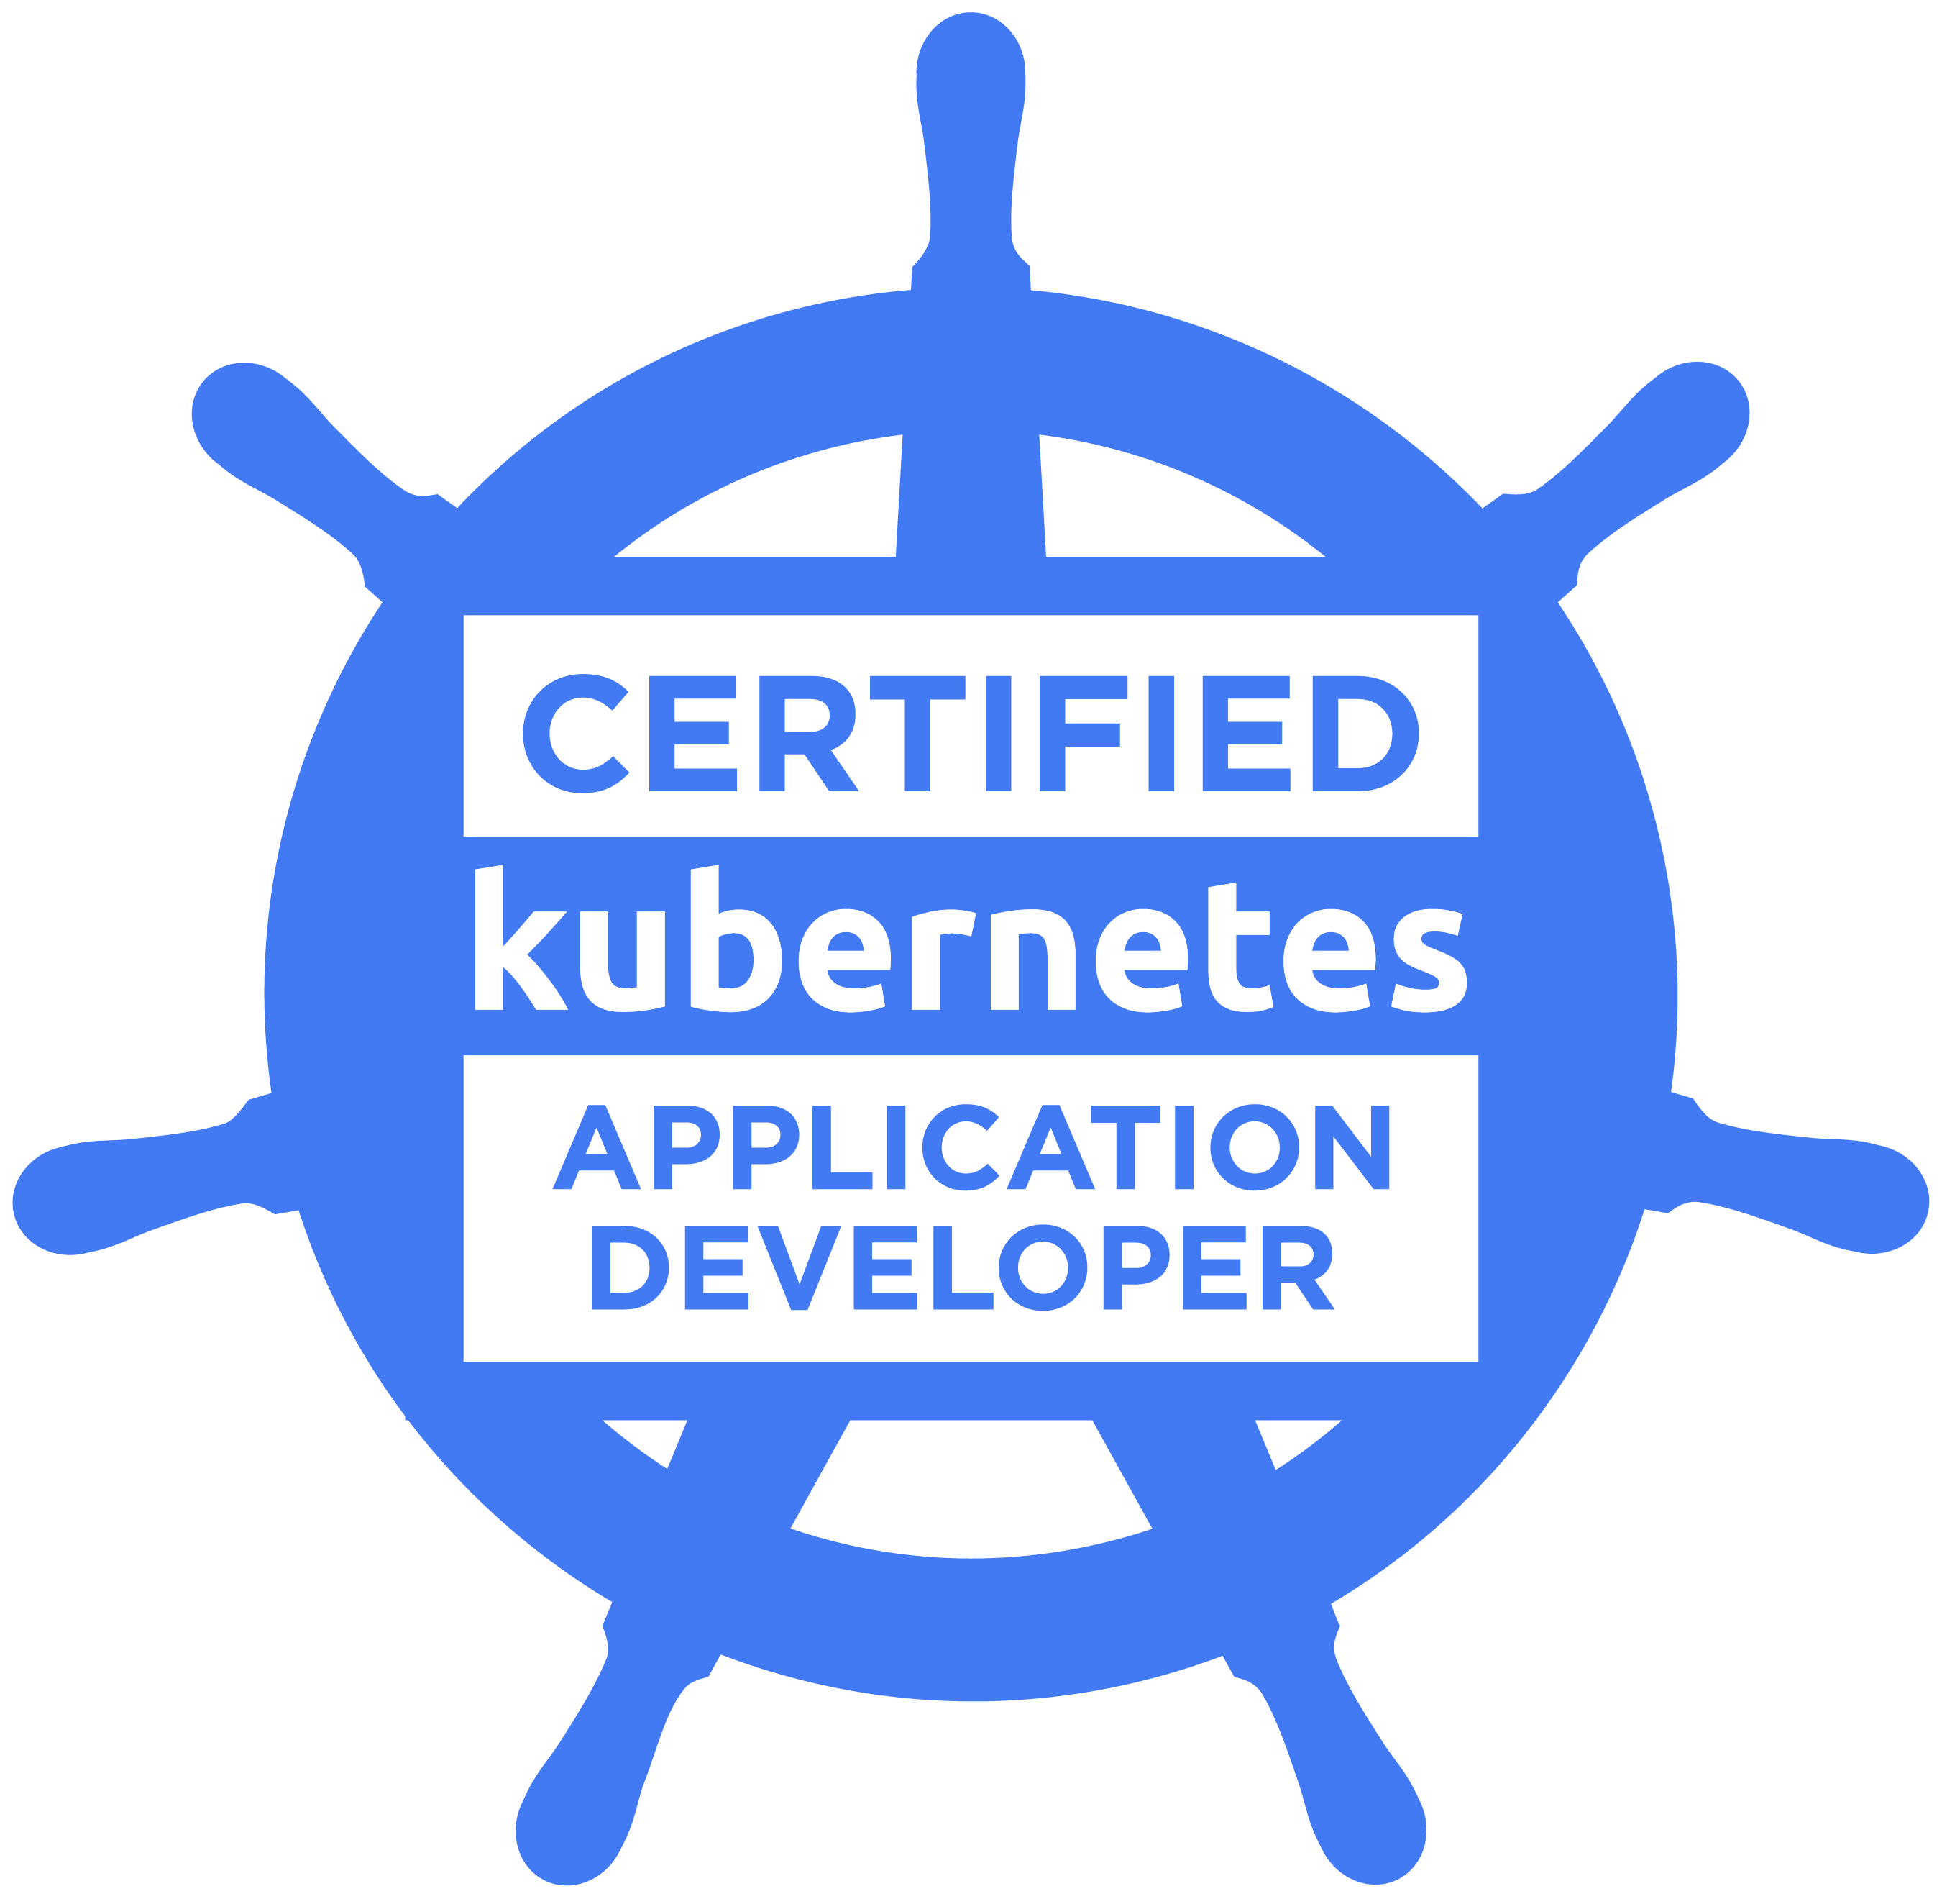
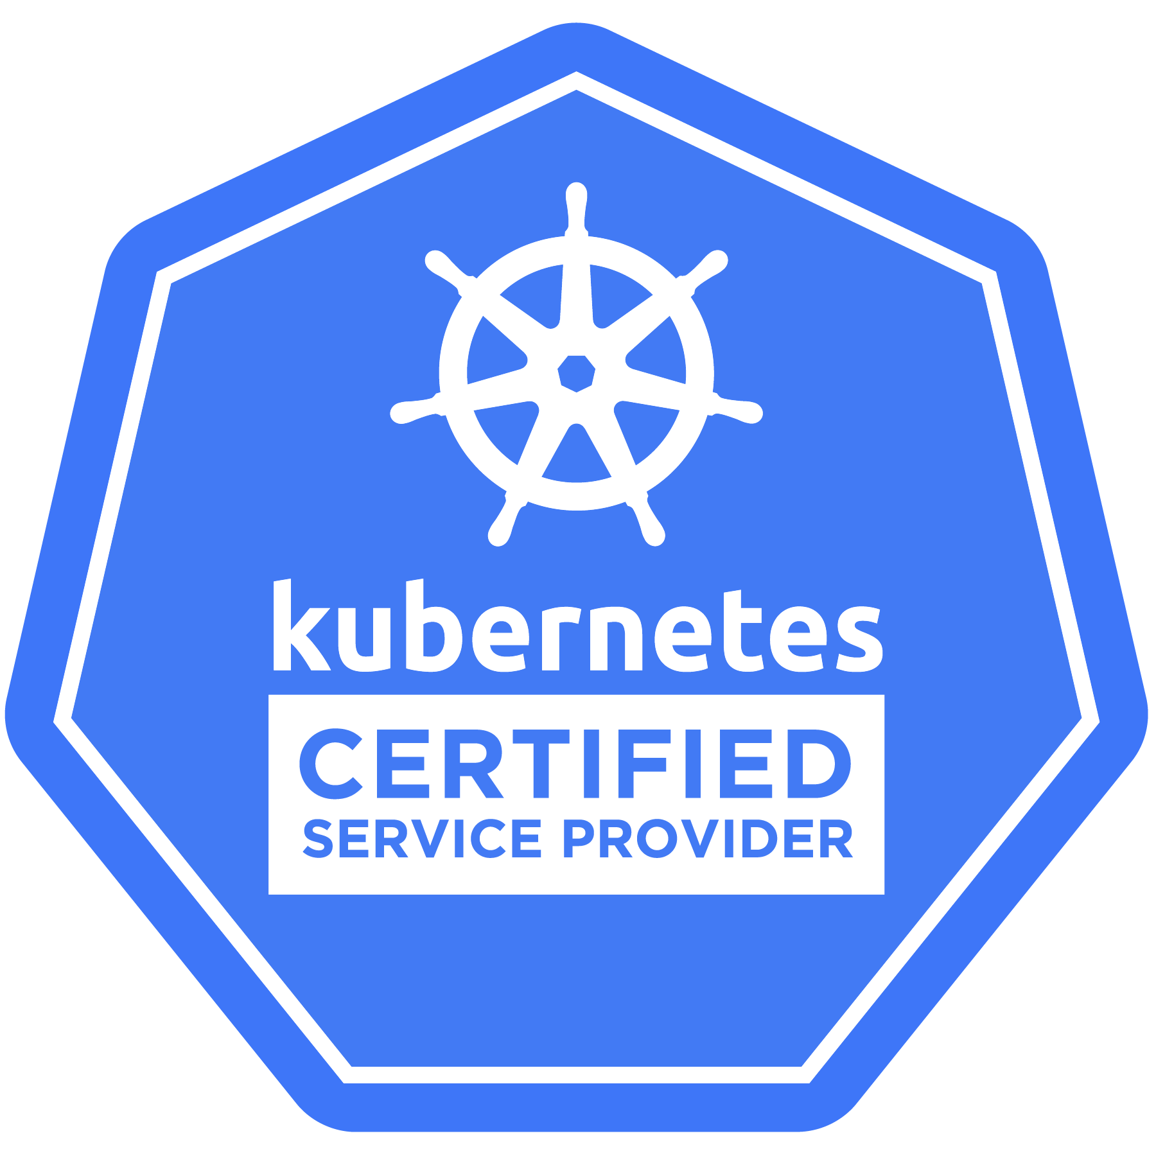
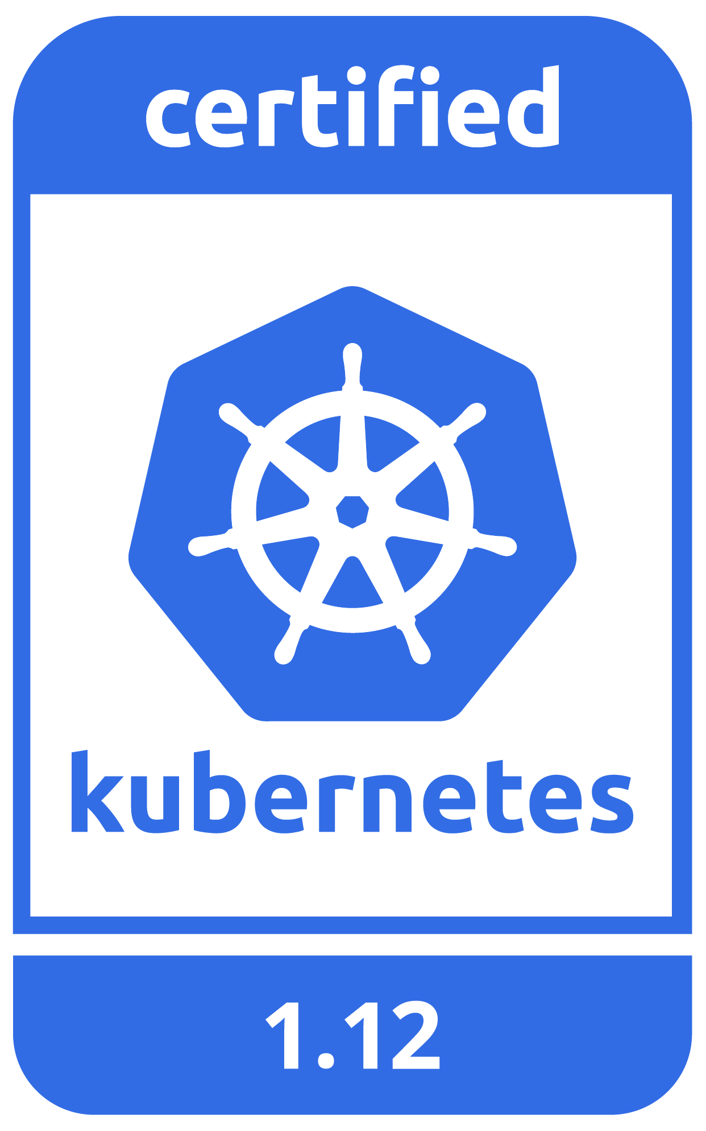
The Programs
Certified Kubernetes Administrator (CKA) Program
Focuses on the deployment, configuration, and troubleshooting skills required to successfully administer a Kubernetes cluster
Certified Kubernetes Application Developer (CKAD) Program
Focuses on defining application resources and using core primitives to build, monitor, and troubleshoot applications in Kubernetes
Kubernetes Certified Service Provider (KCSP) Program
Partner organizations that offer Kubernetes support, consulting, professional services and training
Certified Kubernetes Conformance Program (CKCP)
Ensures vendor versions of Kubernetes support the required APIs and guarantees interoperability from one Kubernetes installation to the next

Slide 4
CKA / CKAD Exams
Candidates demonstrate their competence by solving a set of performance-based problems in a command-line environment that tests their Kubernetes Administrator and Application Developer skills
CKA includes 24 problems
CKAD consists of 19 problems
Online, proctored exam – take your test from any computer with reliable internet and a webcam (a quiet environment is recommended)
CKA candidates have 3 hours to complete the exam
CKAD candidates have 2 hours to complete the exam
Candidates may use their browser to access information at https://kubernetes.io/docs/ or https://kubernetes.io/blog/
CKA was the first of the programs and currently most popular–more than 3200 registrations for the CKA exam as of Oct 2018

Slide 5
CKA / CKAD Exam Details
How much do the exams cost?
Each exam is $300 USD and include a free retake
What version of Kubernetes is used in the exam?
Quarterly exam updates match Kubernetes releases so that the exam reflects the latest version of Kubernetes
How are the exams proctored?
Remotely via streaming audio, video, and screensharing, allowing proctors to view candidates’ desktops
What language(s) are the exams offered In?
The CKA and CKAD exams are currently offered in English only
How are the exams scored?
Scoring is automated and results are emailed within 36 hours from the time that the Exam was completed and
How long is the certification valid?
The certification is valid for 2 years starting on the date the exam is passed

Slide 6
What's on the CKA Exam?
Application Lifecycle: rollouts and rollbacks, scaling - 8%
Installation, Configuration & Validation: HA cluster config, install from binaries, infra deployment - 12%
Core Concepts: API primitives, cluster architecture, network primitives - 19%
Networking: Ingress, cluster DNS, Pod and node networking configuration, load balancing - 11%
Scheduling: using labels for scheduling, DaemonSets, configure one or more schedulers - 5%
Security: configure authN & authZ, NetworkPolicies, set up TLS certificates for cluster components - 12%
Cluster Maintenance: cluster upgrades, backup and restore procedures - 11%
Logging / Monitoring: monitor & manage logs for cluster cluster components and applications - 5%
Storage: PersistentVolumes, PersistentVolumeClaims, volume access modes - 7%
Troubleshooting: application and cluster component failure, network troubleshooting - 10%
There may be more than one way to solve a given problem; with only 7 minutes per question, utilize the quickest solution!
For example, installing Kubernetes can be done a number of ways, which is best?

Slide 7
What's on the CKAD Exam?
Core Concepts: API primitives & basic Pods - 13%
Configuration: resource requests & limits, SecurityContexts, ConfigMaps, Secrets, ServiceAccounts - 18%
Multi-Container Pods: ambassador, adapter, and sidecar patterns - 10%
Observability: liveness & readiness probes, logging, monitoring - 18%
Pod Design: rollouts & rollbacks, Jobs & CronJobs, metadata (labels, selectors, annotations) - 20%
Services & Networking: Service configs, NetworkPolicies - 13%
State Persistence: PersistentVolumeClaims - 8%
Practice the most efficient techniques for creating, editing, and patching specs
Use imperative commands and flags to avoid yaml
The CKAD only allows 6 minutes per question!

Slide 8
CKA / CKAD Resources
How Heptio Engineers Ace the Certified Kubernetes Administrator Exam
Read the Manual – CKA website, FAQ, Candidate Handbook
Study the Learning Materials – Linux foundation training, Kubernetes Up & Running by Hightower, Burns, and Beda
Practice, Practice, Practice – with Kubernetes the Hard Way, Kubernetes from Scratch docs and the Katacoda interactive browser-based scenarios
– Ross Kukulinski, Heptio
Exam curriculum guides: https://github.com/cncf/curriculum
Certification FAQ: https://www.cncf.io/certification/cka/faq/
Candidate Handbook: https://www.cncf.io/certification/candidate-handbook
Exam tips: https://www.cncf.io/certification/tips
Kubernetes from Scratch: https://kubernetes.io/docs/setup/scratch/
Kubernetes Up & Running: http://shop.oreilly.com/product/0636920043874.do
Kubernetes the Hard Way:
https://github.com/kelseyhightower/kubernetes-the-hard-way
Katacoda Interactive Browser-Based Scenarios: https://www.katacoda.com/courses/kubernetes

Slide 9
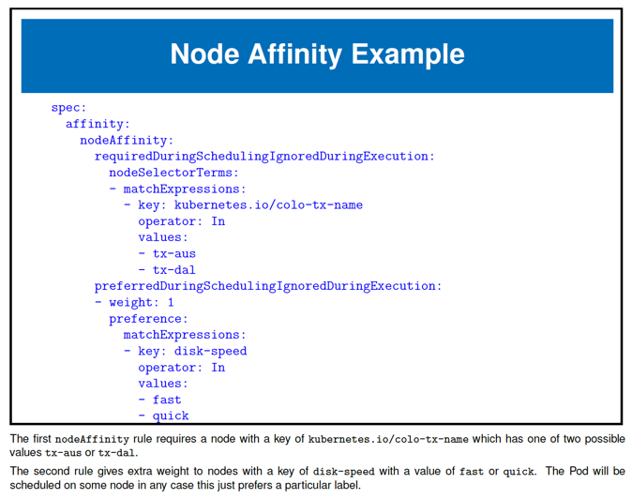
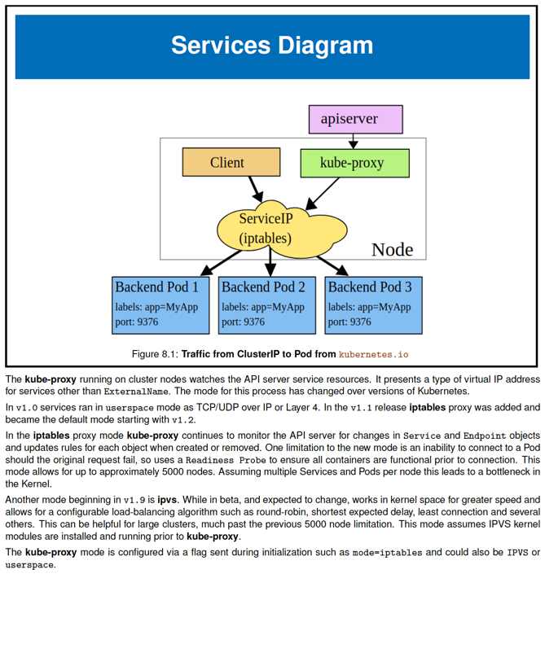
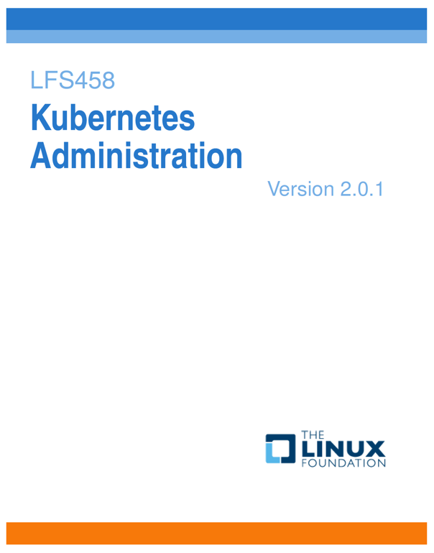
Get Trained!
Introduction to Kubernetes (LFS158) – free edX course !!
https://www.edx.org/course/introduction-to-kubernetes#!
Online, self-paced, ~15 hours of content
Kubernetes Fundamentals (LFS258) https://training.linuxfoundation.org/training/kubernetes-fundamentals/
Online, self-paced, 35 hours of content, including hands-on labs and videos
Includes 12 months of access
Kubernetes for Developers (LFD259) https://training.linuxfoundation.org/training/kubernetes-for-developers/
Online, self-paced, 35 hours of content, including hands-on labs and videos
Includes 12 months of access
Kubernetes Administration (LFS458)
https://training.linuxfoundation.org/training/kubernetes-administration/
Instructor-led training delivered online or in-person by Linux Foundation instructors and/or authorized training partners
Designed as preparation for the Kubernetes Certified Administrator Exam

Slide 10
KCSP Program Details
Program requirements:
Three or more engineers who pass the CKA exam
Demonstrable activity in the Kubernetes community
A business model to support enterprise end users
CNCF membership
Benefits to participating organizations:
Placement on the Kubernetes partner web page
Monthly meetings with the TOC, CNCF project leadership and Governing Board
Access to leads from end users inquiring about support
Benefits to engaging a KCSP services organization:
Proven expertise helping enterprises move to a cloud native platform
Trusted and vetted partner to support your production and operational needs
Demonstrated ability distributing and operating Kubernetes

Slide 11
Software Conformance
There are currently over 80 Kubernetes platforms and distributions!
Guaranteed Portability & Interoperability: conformance ensures that vendor versions of Kubernetes support the required APIs so that user workloads can run without having to test against every K8s environment
Timely Updates: certification is versioned, as Kubernetes architecture changes, certification requirements will change. Platforms must complete a recertification each year for the current or previous version of Kubernetes to remain certified
Previously certified implementations remain certified as long as a newer version is certified at least once a year
Confirmability: end users can confirm that their distribution or platform remains conformant by running the identical open source conformance application (Sonobuoy) that was used to certify

Slide 12
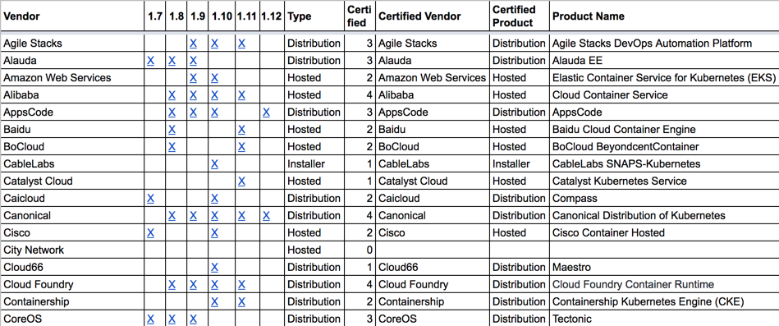
Finding a Certified Vendor
Look for the logo! Most vendors are proud of their certification
CNCF manages a spreadsheet of certified distributions and platforms: https://docs.google.com/spreadsheets/d/1LxSqBzjOxfGx3cmtZ4EbB_BGCxT_wlxW_xgHVVa23es/
A Distribution is software based on Kubernetes that can be installed by an end user on to a public cloud or bare metal and includes patches, additional software, or both
A Hosted platform is a Kubernetes service provided and managed by a vendor
An Installer downloads and then installs vanilla upstream Kubernetes

Slide 13
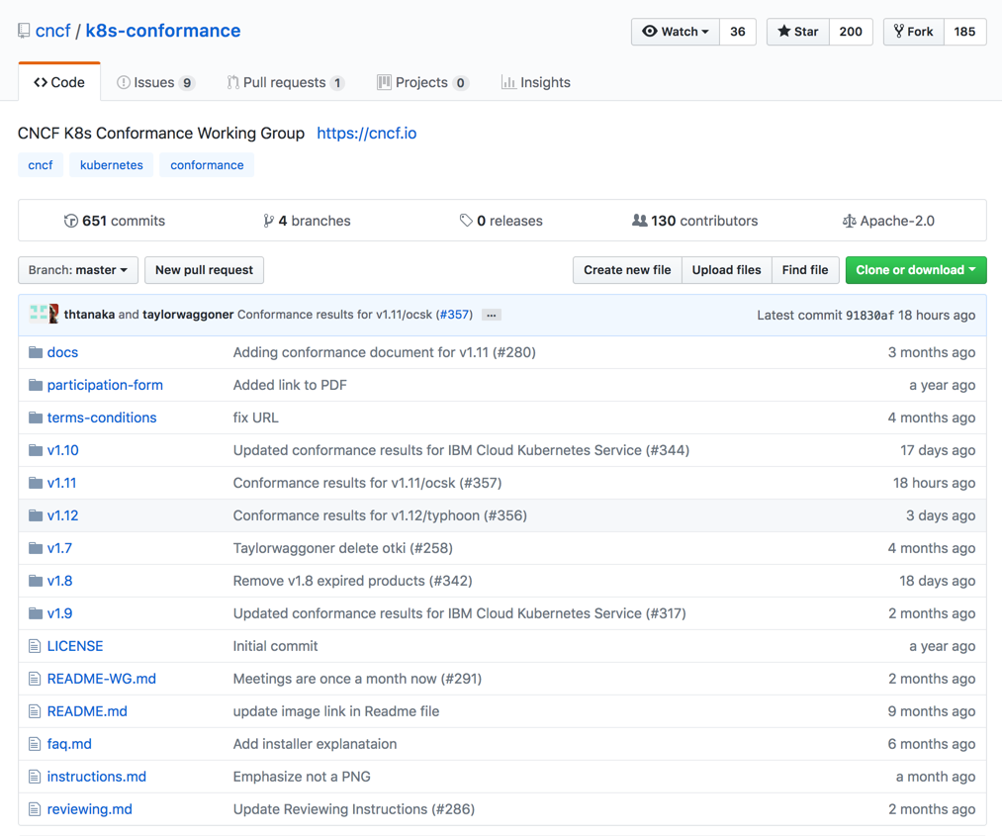
Achieving Conformance
Confirm through self-testing (https://github.com/cncf/k8s-conformance/blob/master/instructions.md) that the platform/distribution/installer is a qualifying offering
Submit and have results accepted by the CNCF
Abide by the terms and conditions of the Conformance Program (https://github.com/cncf/k8s-conformance/blob/master/terms-conditions/Certified_Kubernetes_Terms.md), including subsequent re-testing
End user independent tests must pass; if an end user test fails, you must fix issues it identifies

